Slide 1
Applied Physics
Practical – Lab 2
Resistor

Slide 2
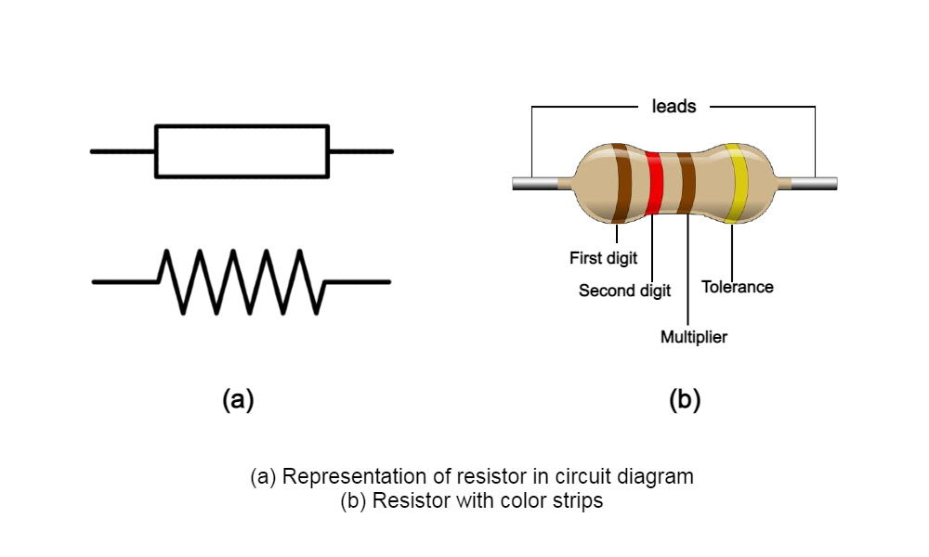
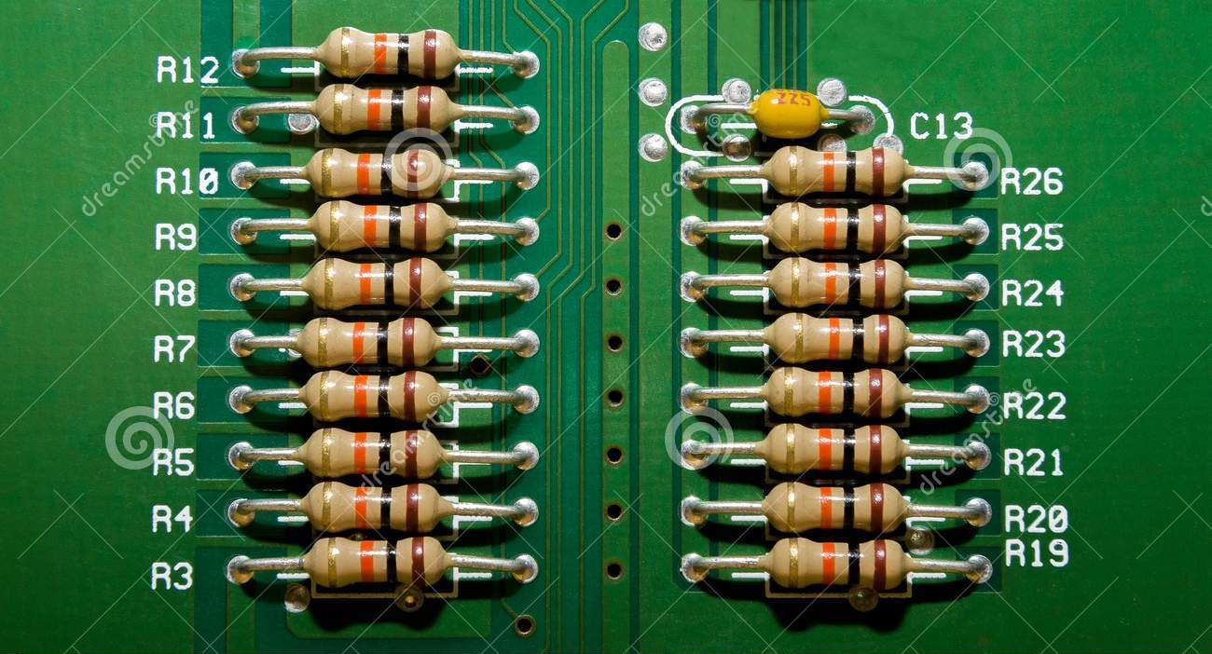
Resistor
A resistor is a passive electrical component with the primary function to limit the flow of electric current.
Resistors absorb power from a circuit and convert it into heat .

Slide 3
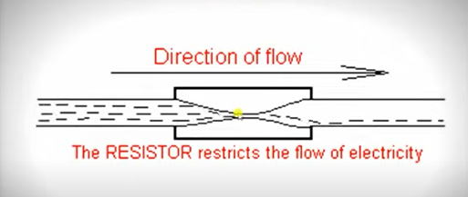
Resistor
In electronics circuits resistors are used to limit current flow, to adjust signal levels.

Slide 4
Resistor
Resistance was discovered by the year the year 1827 from Georg Simon Ohm , a German electrician.
G.S Ohm described this behaviour and game the name “resistance”. He then announced the Ohm’s law that connect the resistance with voltage and current.
The unit of resistance is Ohm (Ω) as memorial to its inventor.

Slide 5
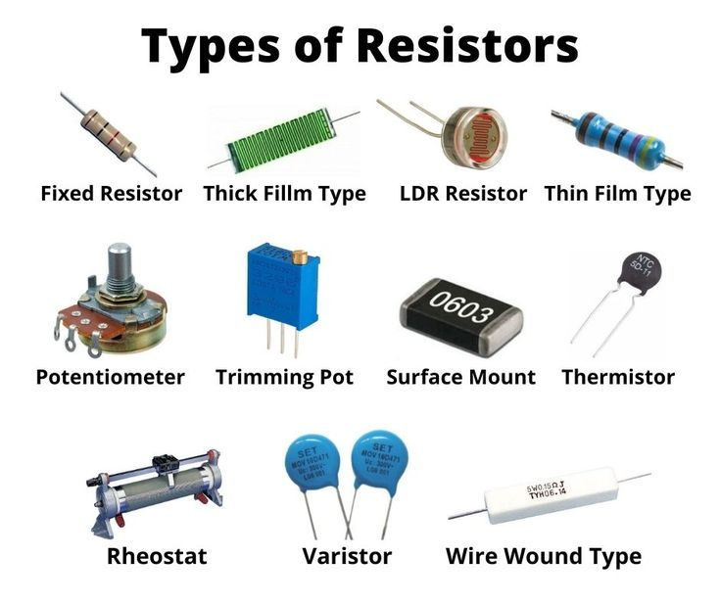
Resistor

Slide 6
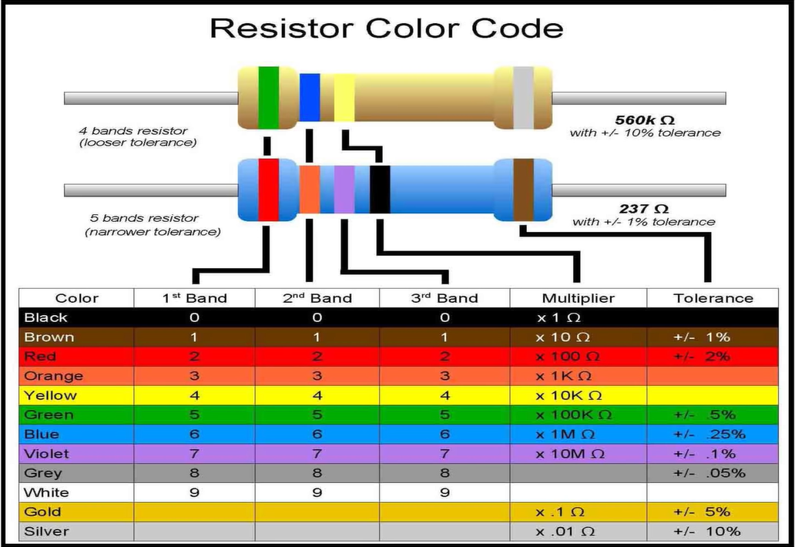

Slide 7
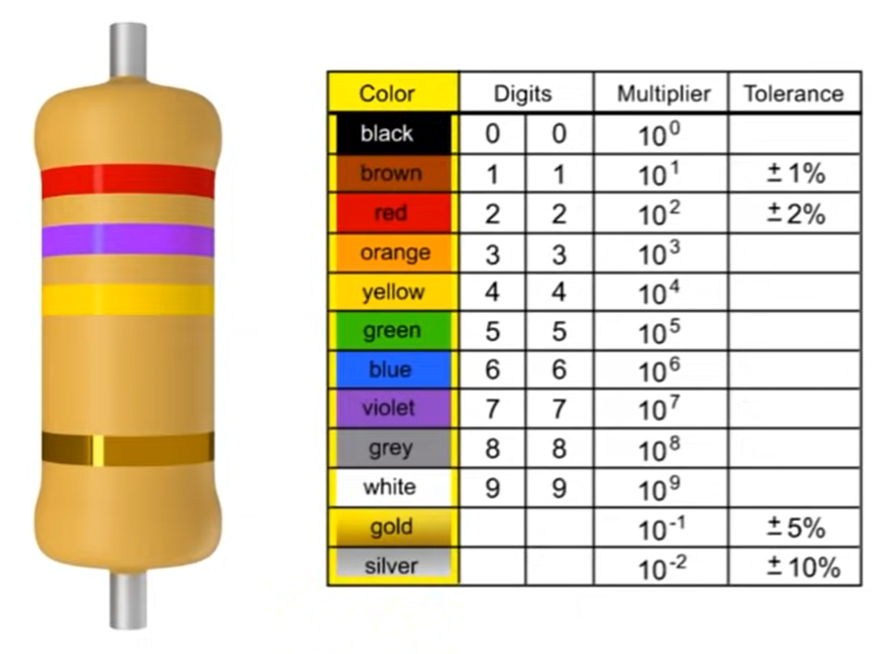

Slide 8
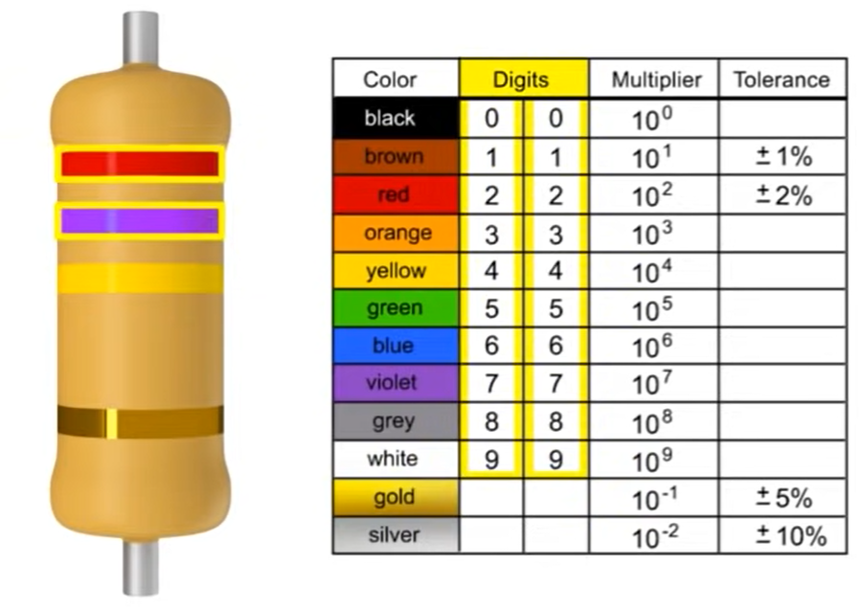

Slide 9
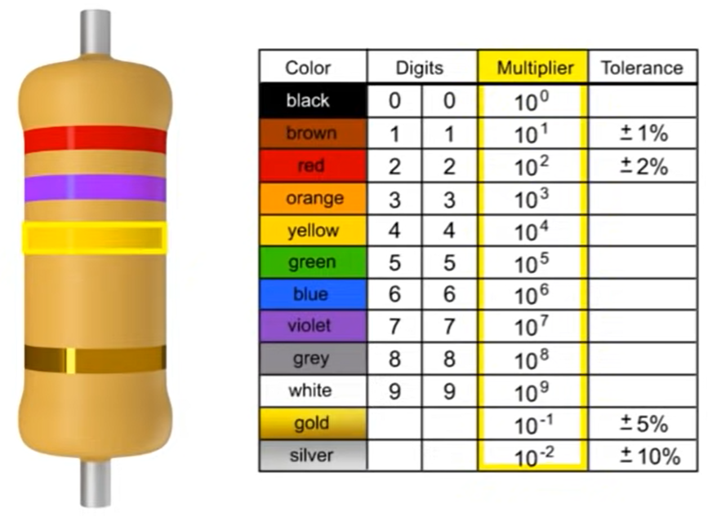

Slide 10
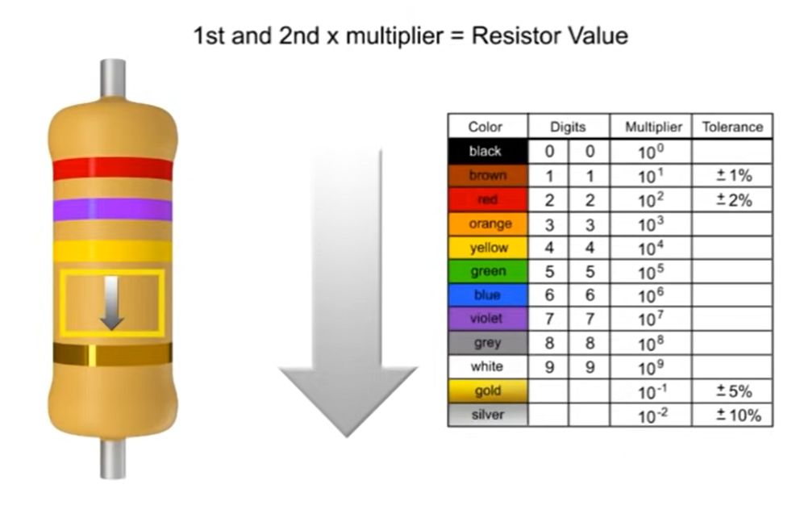

Slide 11
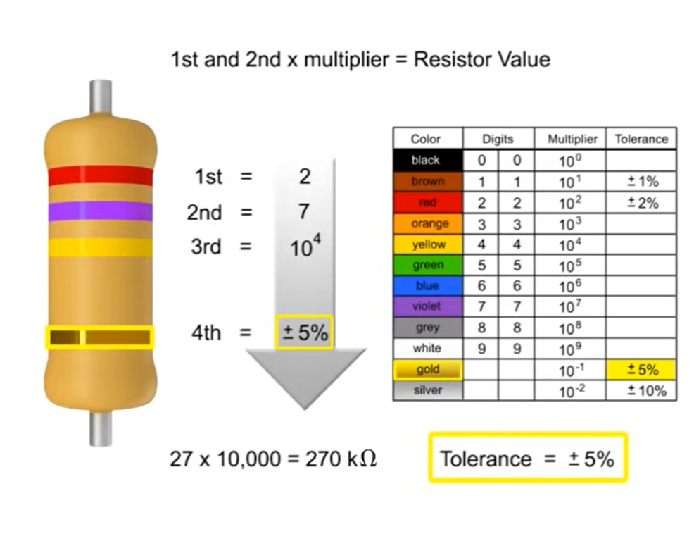

Slide 12
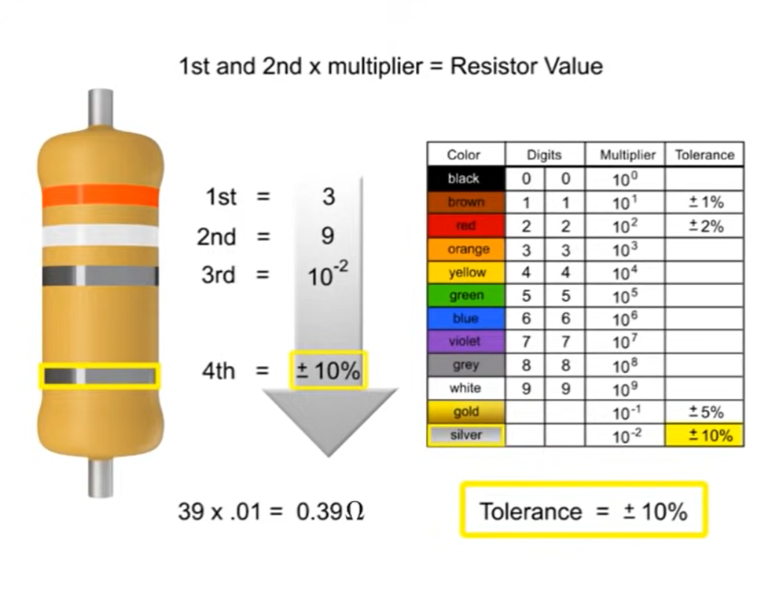

Slide 13
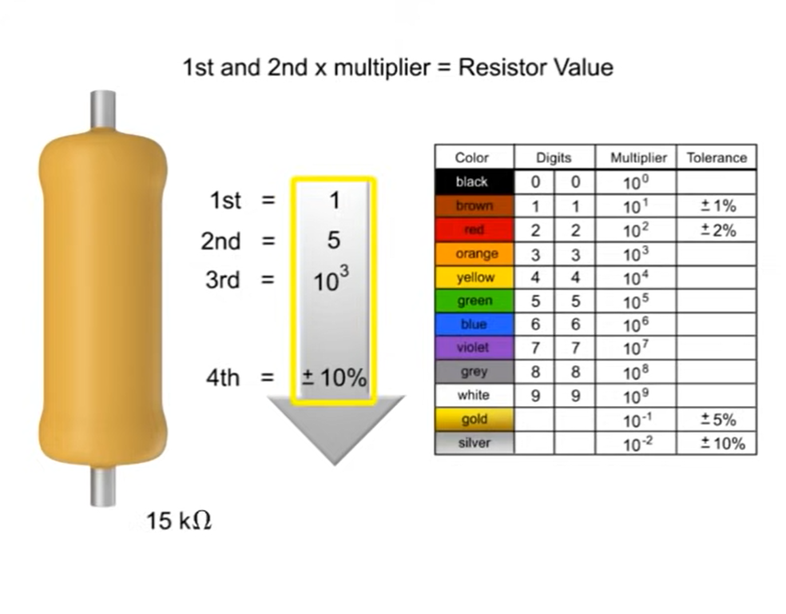

Slide 14
